Slide 1
Bio-Inspired Design
Concept Document
Ranadeep
EDM18b046

Slide 2
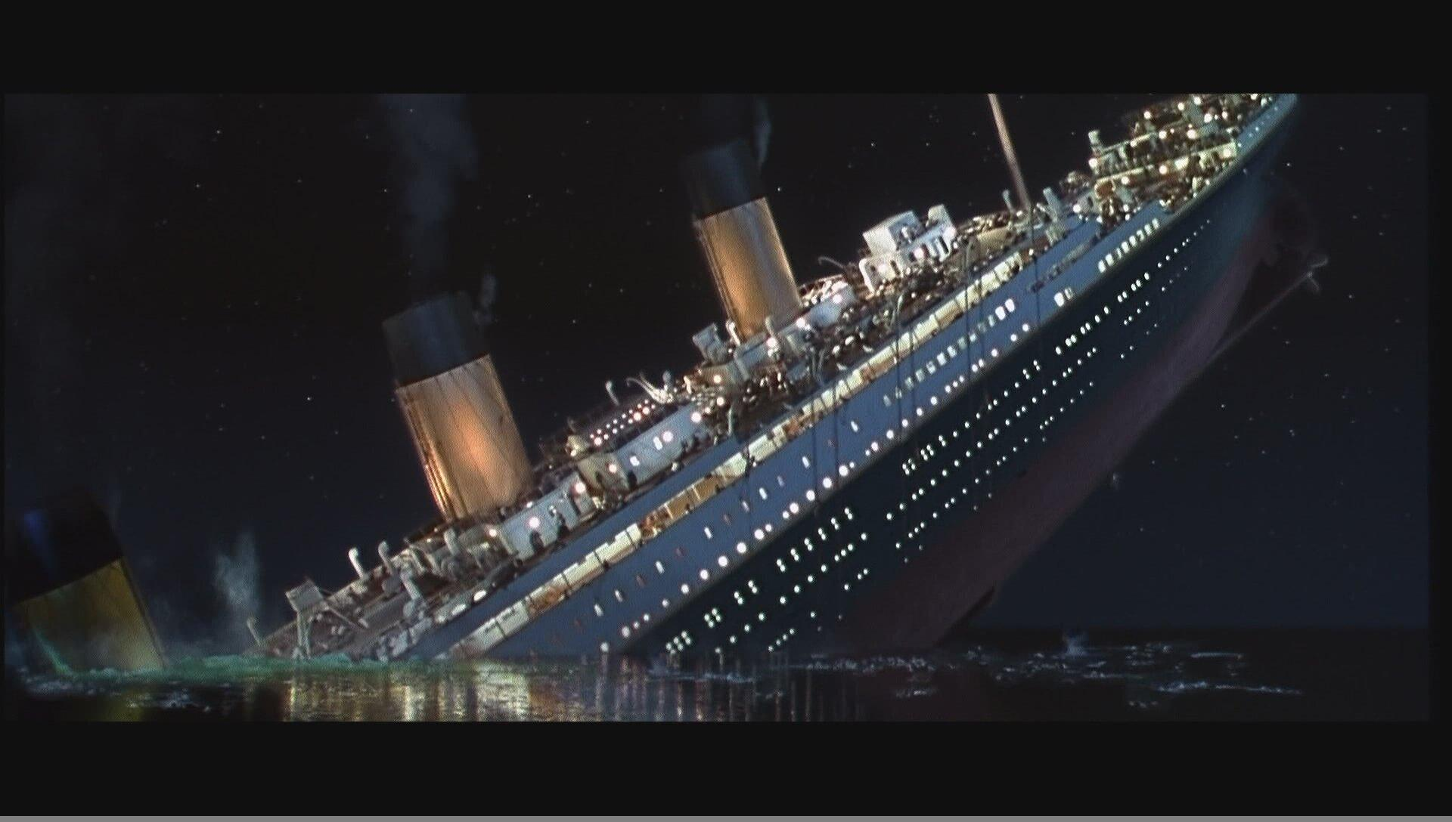
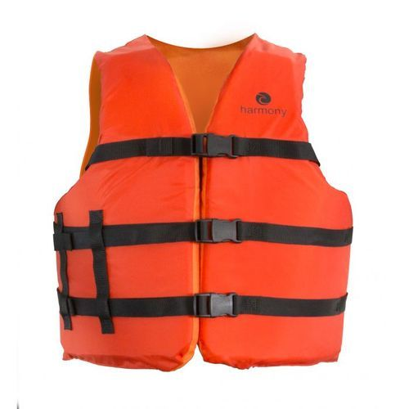
Problem Statement: Marine Coat (mobility in oceanic waters).
Understandings:
Since ocean is not our favorable environment so sometimes we must escape from dangerous situations in ocean and we need to survive in that environment. There are some technologies such as life jacket which helps us to survive for some time but it does not gives us mobility. For these type of situations we are developing a suit which makes the environment favorable, supports our mobility and survival.

Slide 3
Approach:
For mobility in ocean waters we can have a heavy approach that is using a larger machinery like submarine type technology and other is single independent technology designed to wear.
We are proceeding with a independent technology which can easily wear and remove and completely personal and no extra knowledge is needed for operation.

Slide 4
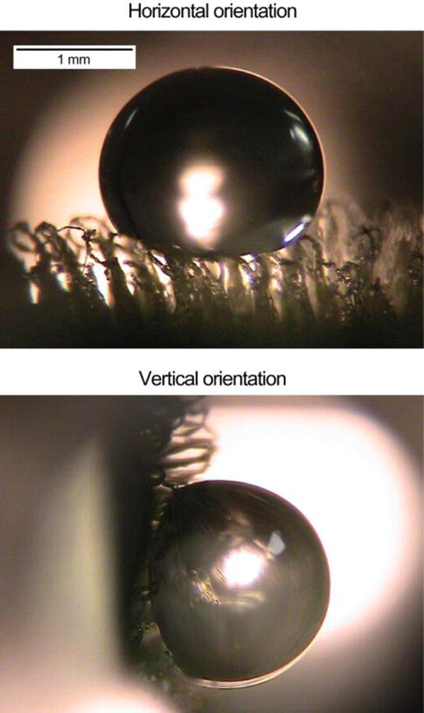
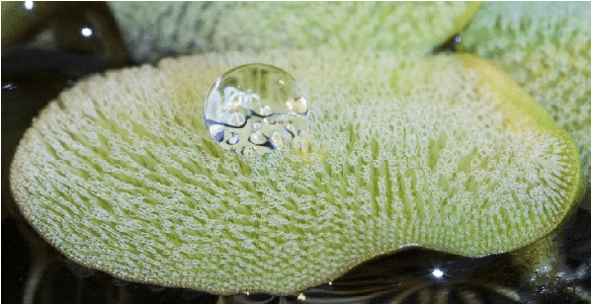
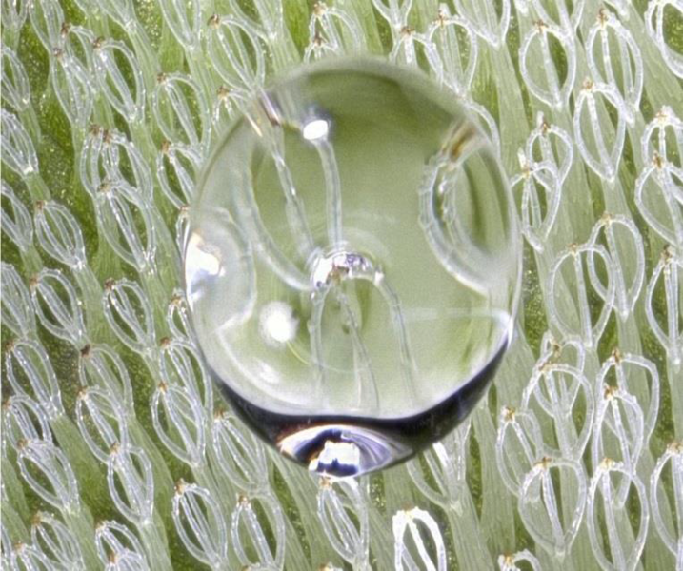
Inspiration:
Salvinia molesta
It is a free floating plant that does not attach to the soil, but instead remains buoyant on the surface of a body of water where its hierarchical construction gives ability to trap air on its surface. It has a hydrophobic base and hair like structure on the base which has hydrophilic tip this layer locks air in between the microstructures. This type of form in our suit gives us a better buoyancy in our movement.
Link :-
https://asknature.org/idea/air-trapping-coating-for-ships-submarines/

Slide 5
Some fishes which uses vortex in ocean for its mobility.
Many fish swim using an undulating motion of their bodies. The muscle activity that bends the body and produces these movements during steady, continuous swimming can cost a significant amount of energy. But some fishes, such as rainbow trout, can adopt a special swimming behavior that likely enables them to save their own energy by extracting energy from nearby water vortices. In a fluid environment, vortices are swirls of water or air often released (or “shed”) from stationary objects and other living creatures, including other fish, that are in the path of an oncoming flow. Trout use water vortices that come their way from upstream sources to their advantage by adjusting their typical swimming behavior to produce a ‘slalom’ movement between vortices. Body bends increase in amplitude and curvature, and the tail beats at a frequency that matches the frequency at which vortices are shed upstream. The pattern of muscle activity along the body also changes, where only muscles close to the head are active. This differs from typical undulating motion where muscles contract all along the body, starting from the head and moving toward the tail to produce a traveling body wave that pushes the fish forward.
Link :-
https://asknature.org/strategy/body-uses-vortices-to-save-energy/

Slide 6
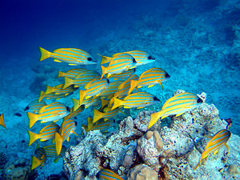
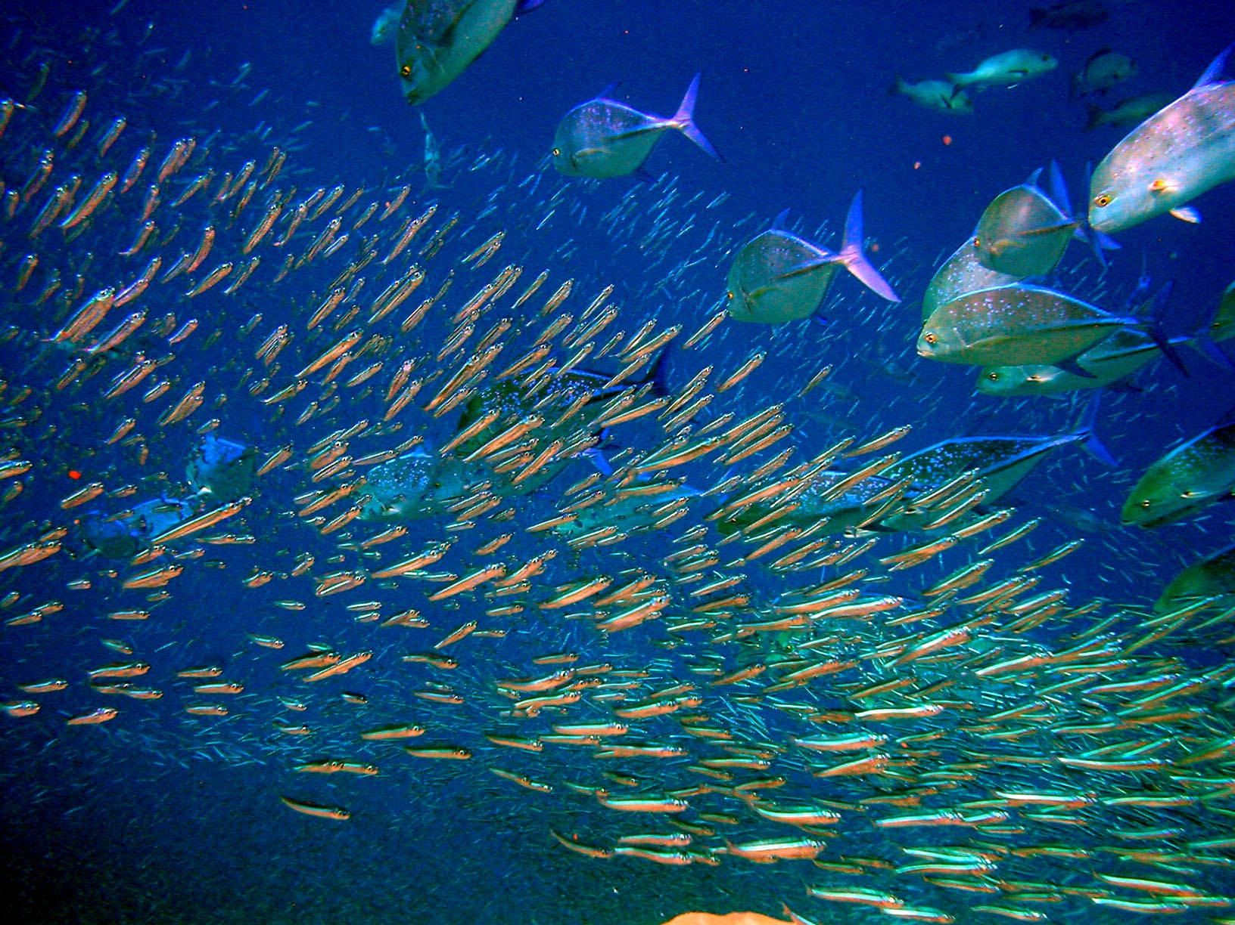
3. Shoaling (schooling) in fishes
When environment is not suitable to us or we alone are weak in that environment then togetherness gives us strength to survive. Many biological systems follow this strategy to survive themselves. Here our main function is mobility this must be executed in a more efficient way such that less energy is consumed. Fishes follow this type of strategy when they are large in number this technique becomes more efficient by knowledge sharing between them.
Link :-
https://en.wikipedia.org/wiki/Shoaling_and_schooling

Slide 7
Parameterization:
Environment parameters.
Salinity
Temperature
Density
Ocean current speed
Direction of current
Inspiration parameters [Structure].
Shape of hair-like structure
Periodicity
Length of hair-like structure
Inspiration parameters [Mobility].
Vortex frequency
Body alignment angle

Slide 8
Supporting technologies:
Nano technology :-
Since the hierarchal structure on the surface of the suit is in the range of nanometers therefore we require knowledge in nano technology for its design.

Slide 9
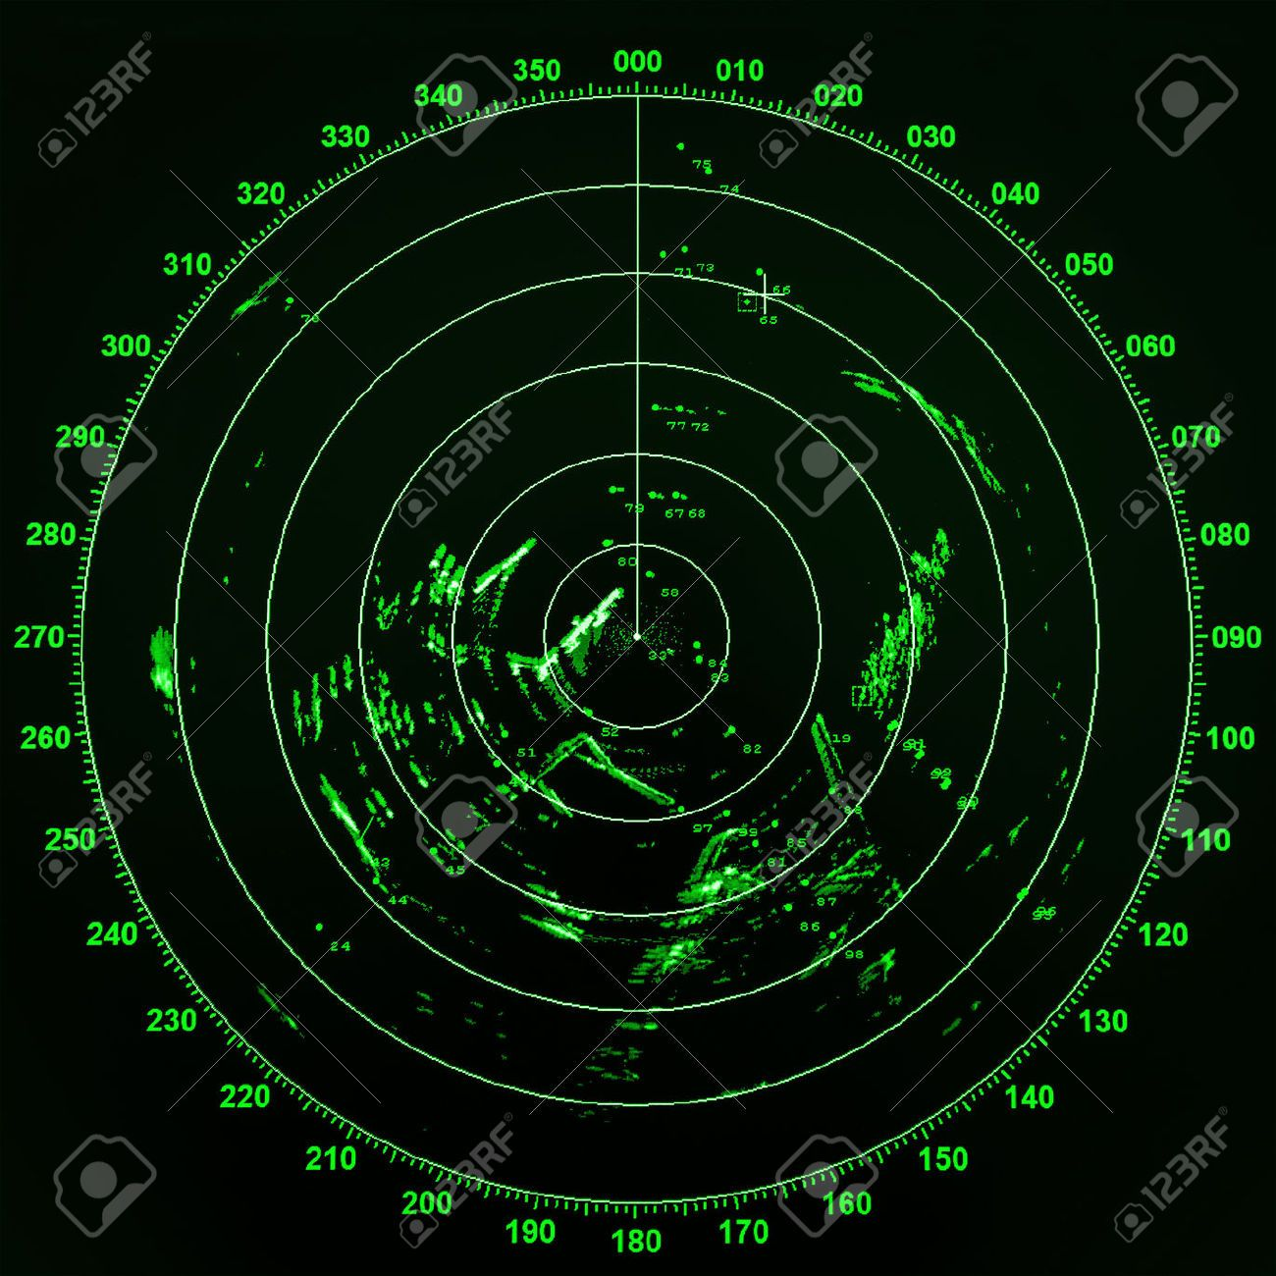
2. Radar technology:
It supports our navigation in the ocean by detecting whether the target is present or not and the range and velocity of the target. Here our target can be our destination, predators or rescue ships etc.

Slide 10
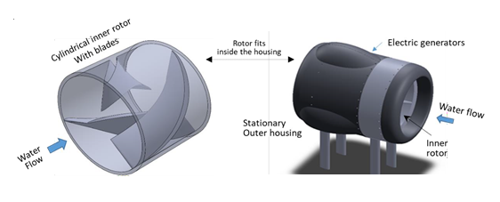
Hydrokinetic technology
This technology is used to power our suit. It converts the ocean waves energy that is hydrokinetic energy to electricity. This technology must be designed in such way that our suit should not become heavy and also for its storage of electricity.

Slide 11
Supporting principles and concepts:
Fluid dynamics
This concept gives us the fluid flow behavior and makes us to adapt the flow so this makes us mobility easy when this type of environment repeats.
2. Static electricity
We can use the concept of static electricity so we can reduce the weight of the system since we use the advantage of larger surface area due to hierarchical microstructure.

Slide 12
Required ecosystem:
Since ocean consists of a wide variety of environments therefore our system is designed for oceanic ecosystem and also for particular range of parameters like for certain depth, salinity, temperature, atmospheric pressure.
We must define the range of parameters where our suits works more efficiently so that there will not be any mis happenings. Since our suit is powered by ocean currents so we are restricted up to 400m depth thereafter we observe a considerably large density change in the water body and currents will be vertical. Therefore we are restricted up to surface waves where our suit powered properly and works properly. Our movement is with the help of already formed vortices therefore ocean must not be very silent.

Slide 13
Bio-Inspired Technology
Now we have a system(marine coat) for mobility in oceanic waters which has hierarchical microstructure which provides it buoyancy for easy movement and it uses vortices in the ocean by other creatures for the mobility so reduce our energy consumption and our suit is powered by oceanic waves and stored in the form of static electricity and there will be always continuous tracking of surroundings with radio waves since we have other harmful systems in this environment and we have a continuous communication between similar systems with radio waves.

Slide 14
